Slide 1
Coping

Slide 2
Answer the following questions by using following scale: 1= Rarely, 2= Occasionally, 3= Frequently, 4= Often, 5 = Always
___How often do you find that you stay online longer than you intended?
___How often do you neglect household chores to spend more time online?
___How often do you prefer the excitement of the Internet to intimacy with your partner?
___How often do you form new relationships with fellow online users?
___How often do others in your life complain to you about the amount of time you spend online?

Slide 3
6. How often do your grades or school work suffer because of the amount of time you spend online?
7. How often do you check your e-mail before something else that you need to do?
8. How often does your job performance or productivity suffer because of the Internet?
9. How often do you become defensive or secretive when anyone asks you what you do online?
10. How often do you block out disturbing thoughts about your life with soothing thoughts of the Internet?
11. How often do you find yourself anticipating when you will go online again?

Slide 4
12. How often do you fear that life without the Internet would be boring, empty, and joyless?
13. How often do you snap, yell, or act annoyed if someone bothers you while you are online?
14. How often do you lose sleep due to late-night log-ins?
15. How often do you feel preoccupied with the Internet when off-line, or fantasize about being online?
16. How often do you find yourself saying “just a few more minutes” when online?
17. How often do you try to cut down the amount of time you spend online and fail?

Slide 5
18. How often do you try to hide how long you’ve been online?
19. How often do you choose to spend more time online over going out with others?
20. How often do you feel depressed, moody, or nervous when you are off-line, which goes away once you are back online?

Slide 6
Scoring: Internet Addiction
NONE 0 – 30 points
MILD 20- 39 points: You are an average online user. You may surf the Web a bit too long at times, but you have control over your usage.
MODERATE 40 -69 points: You are experiencing occasional or frequent problems because of the Internet. You should consider their full impact on your life.
SEVERE 70 – 100 points: Your Internet usage is causing significant problems in your life. You should evaluate the impact of the Internet on your life and address the problems directly caused by your Internet usage.

Slide 7
Coping

Slide 8
Cope
(Of a person) deal effectively with something difficult

Slide 9
Coping
“Efforts to master, reduce, or tolerate the demands created by stress”
General points for consideration:
People cope with stress in many ways.
It is most adaptive to use a variety of coping strategies.
Coping strategies vary in their adaptive value.

Slide 10
Common Coping Patterns
Giving up
People may develop learned helplessness – “passive behavior produced by exposure to unavoidable aversive events”.
Sometimes, could then be transferred to situations in which the person is not really helpless.
This then creates a passive reaction to stressful events, rather than active problem-solving.

Slide 11
A Small Story
“The very thought “Nothing I do matters” prevents us from acting.”
Two fish were put into the same tank. One was big, and one small. The species of the small fish was one of the favorite foods of the big fish. The big fish took off after the little fish, but a pane of glass separated them, so the big fish smashed his face...over and over again. Finally, big fish gave up. Then the experimenters removed the pane of glass, but the big fish never again tried to eat the little fish. Sometimes the two fish would swim right past each other, sometimes they would even brush up against each other, but the big fish never made another attempt.
Apparently, big fish was convinced he/ she couldn't do it, no matter how hard he tried.

Slide 12
Morale of the story:
we can assume our helplessness is permanent, even when it isn't. If we make that assumption, we just give up. We feel hopeless and have no energy, because we believe all our efforts are in vain

Slide 13
Giving up, continued
Cognitive interpretation of aversive events may determine whether we feel helpless or not.
People with a pessimistic explanatory style view aversive events as “out of their control”, feel helpless, and give up.
In general, it has been found that optimists (people who have general expectancies of good outcomes) seem to be much more stress resistant than pessimists (people who have general expectancies for poor outcome).
Hardiness is another characteristic that save an individual from harmful effect of stress. Hardy persons show three characteristics
Exhibit higher levels of commitment
They tend to perceive change as a challenge
They have high sense of personal control over events.

Slide 14
Acting aggressively
Frustration caused by stressful events may elicit aggression, “behavior intended to hurt someone, either physically or verbally”.
People often act out toward others who had nothing to do with their frustration.
Using a substitute target in this manner was called displacement by Freud.

Slide 15
Freud believed aggressive acts could release pent-up emotional tension and called the process catharsis.
However, research finds that acting aggressively produces more, not less, anger and aggression.

Slide 16
Indulging yourself
When stressed by events that are going poorly, some people seek out alternative sources of satisfaction:
Excessive eating, drinking, and smoking;
gambling & drug use; and
Internet addiction – “spending an inordinate amount of time on the Internet and inability to control online use”

Slide 17
Blaming yourself
People often become highly critical of themselves when stressed.
Albert Ellis called this catastrophic thinking, which involves
Attributing failures to personal shortcomings;
Focusing on negative feedback; and
Being overly pessimistic about the future.
This pattern perpetuates negative emotional reactions to stress.

Slide 18
Using defensive coping
Defense mechanisms are “largely unconscious reactions that protect a person from unpleasant emotions such as anxiety and guilt”.
Defense mechanisms shield us from emotional discomfort caused by stress.
However, most involve a degree of self-deception, a distortion of reality.

Slide 19
Defense mechanisms are considered normal, and can operate at various levels of consciousness.
Can they ever be healthy?
Generally, they are not, because
They are avoidance strategies;
They often involve “wishful thinking”; and
Some have been linked to poor health.

Slide 20
Are they healthy?, continued
Sometimes, however, they are useful for severe stress because they buffer us from extremely negative emotions.
(e.g., unrealistic optimism may benefit a terminally ill patient.)

Slide 21
Constructive coping - “refers to efforts to deal with stressful events that are judged to be relatively healthful”.
Constructive coping involves:
Confronting problems directly.
Effort.
Realistic appraisals of stress and coping resources.
Learning to recognize and manage disruptive emotional reactions to stress.
Learning to exert some control over potentially harmful or destructive habitual behaviors.

Slide 22
There are three main categories of constructive coping strategies:
Appraisal-focused
Problem-focused
Emotion-focused

Slide 23
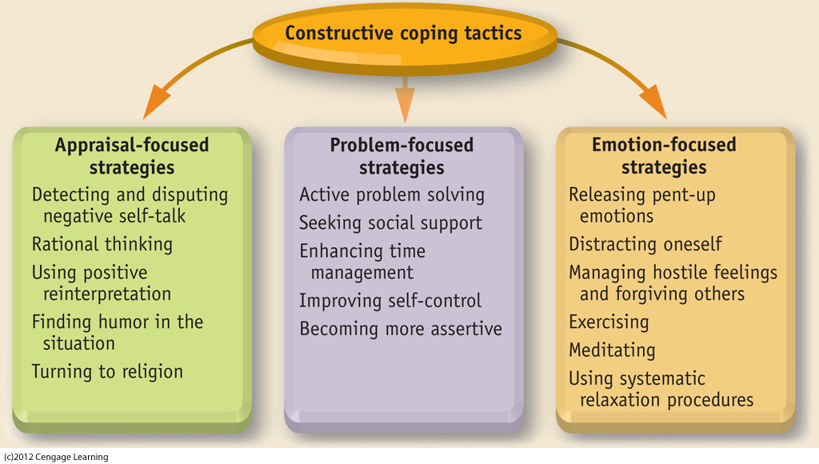
Figure 4.6. Overview of constructive coping tactics. Coping tactics can be organized in several ways, but we will use the classification scheme shown here, which consists of three categories: appraisal-focused, problem-focused, and emotion-focused strategies. The list of coping tactics in each category is not exhaustive. We will discuss most, but not all, of the listed strategies in our coverage of constructive coping.
Notes:
INSERT FIG 4.6

Slide 24
Appraisal-Focused Coping
Our appraisal (or beliefs about stressful events) is critical to the coping process.
Negative appraisals (or beliefs) are often associated with catastrophic thinking, which exaggerates the magnitude of our problems.
Positive (realistic and/or optimistic) appraisals allow constructive coping.

Slide 25
Positive reinterpretation can also buffer stress in the following ways:
We can recognize that “things could be worse”.
We can utilize “benefit finding” in a bad situation (searching for something good in a bad experience).

Slide 26
Problem-Focused Coping
Using systematic problem-solving
Evidence shows that problem-solving skills can be increased through training (Heppner & Lee, 2002, 2005) and by using these steps:
Clarify the problem.
Generate alternative courses of action.
Evaluation alternatives and select a course of action.
Take action while maintaining flexibility.

Slide 27
Seeking help
It is often helpful to seek aid from friends, family, coworkers, and neighbors.
Cultural factors in seeking help:
Asians, Asian Americans, and individuals from collectivistic cultures are less likely to seek help from others.
This is based in a cultural tendency to avoid “burdening” others with one’s problems.

Slide 28
Answer "YES" or "NO" to the following questions.
1. Have you estimated how many hours you need to study this semester?
2. Do you tend to complete your assignments on time?
3. Have you estimated how long it takes to read one chapter in each of your textbooks?
4. Do you begin working on long-term assignments at the beginning of the semester?
5. Do you make lists of things to do in your head rather than on paper?
6. Do you participate in social activities even when you know you should be studying?

Slide 29
7. Do you schedule time to study for exams?
8.Do you have a job that requires more than 20 hours a week?
9. Do you know exactly what tasks you are going to do when you sit down to study?
10. Do you attempt the assignments from your most difficult class first?

Slide 30
Scoring
Give yourself one point for each YES answer to all questions except 5, 6, and 8, and one point for each NO answer to questions 5, 6, and 8. Total your points. A low score indicates a need for help with time management and a high score indicates use of effective time management techniques.

Slide 31
Using time more effectively: Time Management
A common source of stress is feeling there is not enough time to accomplish tasks.
Often, this can be improved by using the time we have more effectively.

Slide 32
Using time more effectively, continued
The causes of wasted time
Inability to set or stick to priorities.
Inability to say “no” to others’ demands on our time.
Inability to delegate responsibility.
Inability to throw things away.
Inability to accept anything less than perfection.

Slide 33
Using time more effectively, continued
The problem of procrastination
About 70-90% of college students put off academic assignments (Knaus, 2000).
Many claim to benefit from this tactic (e.g., saying they “work well under pressure”).

Slide 34
Why do students procrastinate?
Desire to minimize time on a task.
Desire to optimize efficiency.
Close proximity to reward.
Students often get rewarded for it.
However, procrastinators also tend to experience more anxiety and health problems.

Slide 35
Time management techniques
Monitor your use of time – keep a record to see where it all goes (see Figure 4.11).
Clarify your goals – decide what you want to accomplish with your time.
Plan your activities using a schedule – planning saves time in the long run.

Slide 36
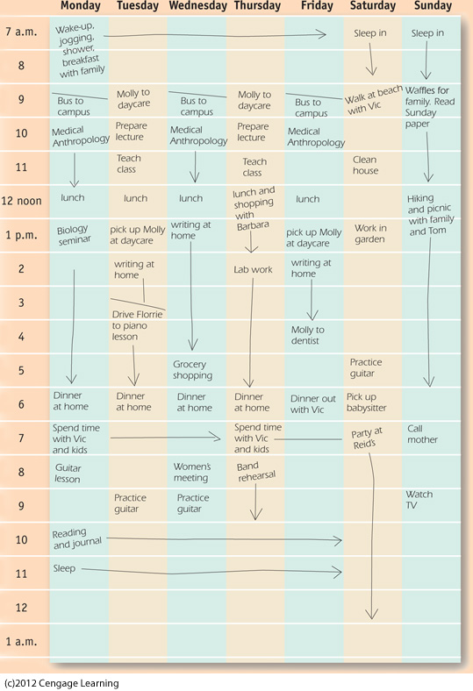
Figure 4.11. Example of a time log. Experts recommend keeping a detailed record of how you use your time if your are to improve your time management. This example shows the kind of record keeping that should be done.

Slide 37
Protect your prime time – announce to others when you’re blocking off certain times to work so you won’t be interrupted.
Increase your efficiency. Try these tips:
Handle paper once.
Tackle one task at a time.
Group similar tasks together.
Make use of your “downtime”.

